Slide 1
Comparison of Linear and Nonlinear Dimensionality Reduction Methods for Image Reconstruction
Final Update Presented By: Taylor Davis and Kaleb Coleman
Notes:
TJ

Slide 2
Problem Reminder
High-dimensional images are expensive to store and process
Dimensionality reduction compresses images into smaller representations
PCA is classical & linear
Autoencoders are neural & nonlinear
Question: Which reconstructs images better under equal compression?
Image
Latent Code
(k dimensions)
Reconstructed Image
Notes:
TJ- High-dimensional images are expensive to store and process. Even a small 28×28 grayscale image contains 784 dimensions. Larger modern images can contain hundreds of thousands.
Dimensionality reduction allows us to compress these images into smaller latent representations while preserving as much structure as possible.
PCA is a classical, linear approach grounded in linear algebra. Autoencoders, on the other hand, are neural and nonlinear.
So our central question is: under equal compression, which method reconstructs images more accurately?

Slide 3
Methods Overview
PCA
- Linear Projection
- No Gradient Training
- Parameter Efficient
Autoencoder
- Nonlinear Encoder/Decoder
- Learns Latent Representation
- More flexible, but more expensive
Diffusion
- Bonus!
Notes:
Kaleb

Slide 4

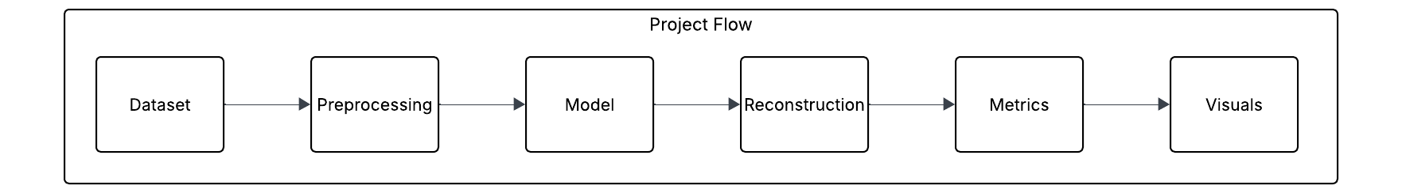
Implementation Update
PCA Module
AE Module
Full Comparison Module
Diffusion Bonus Module
Notes:
TJ

Slide 5
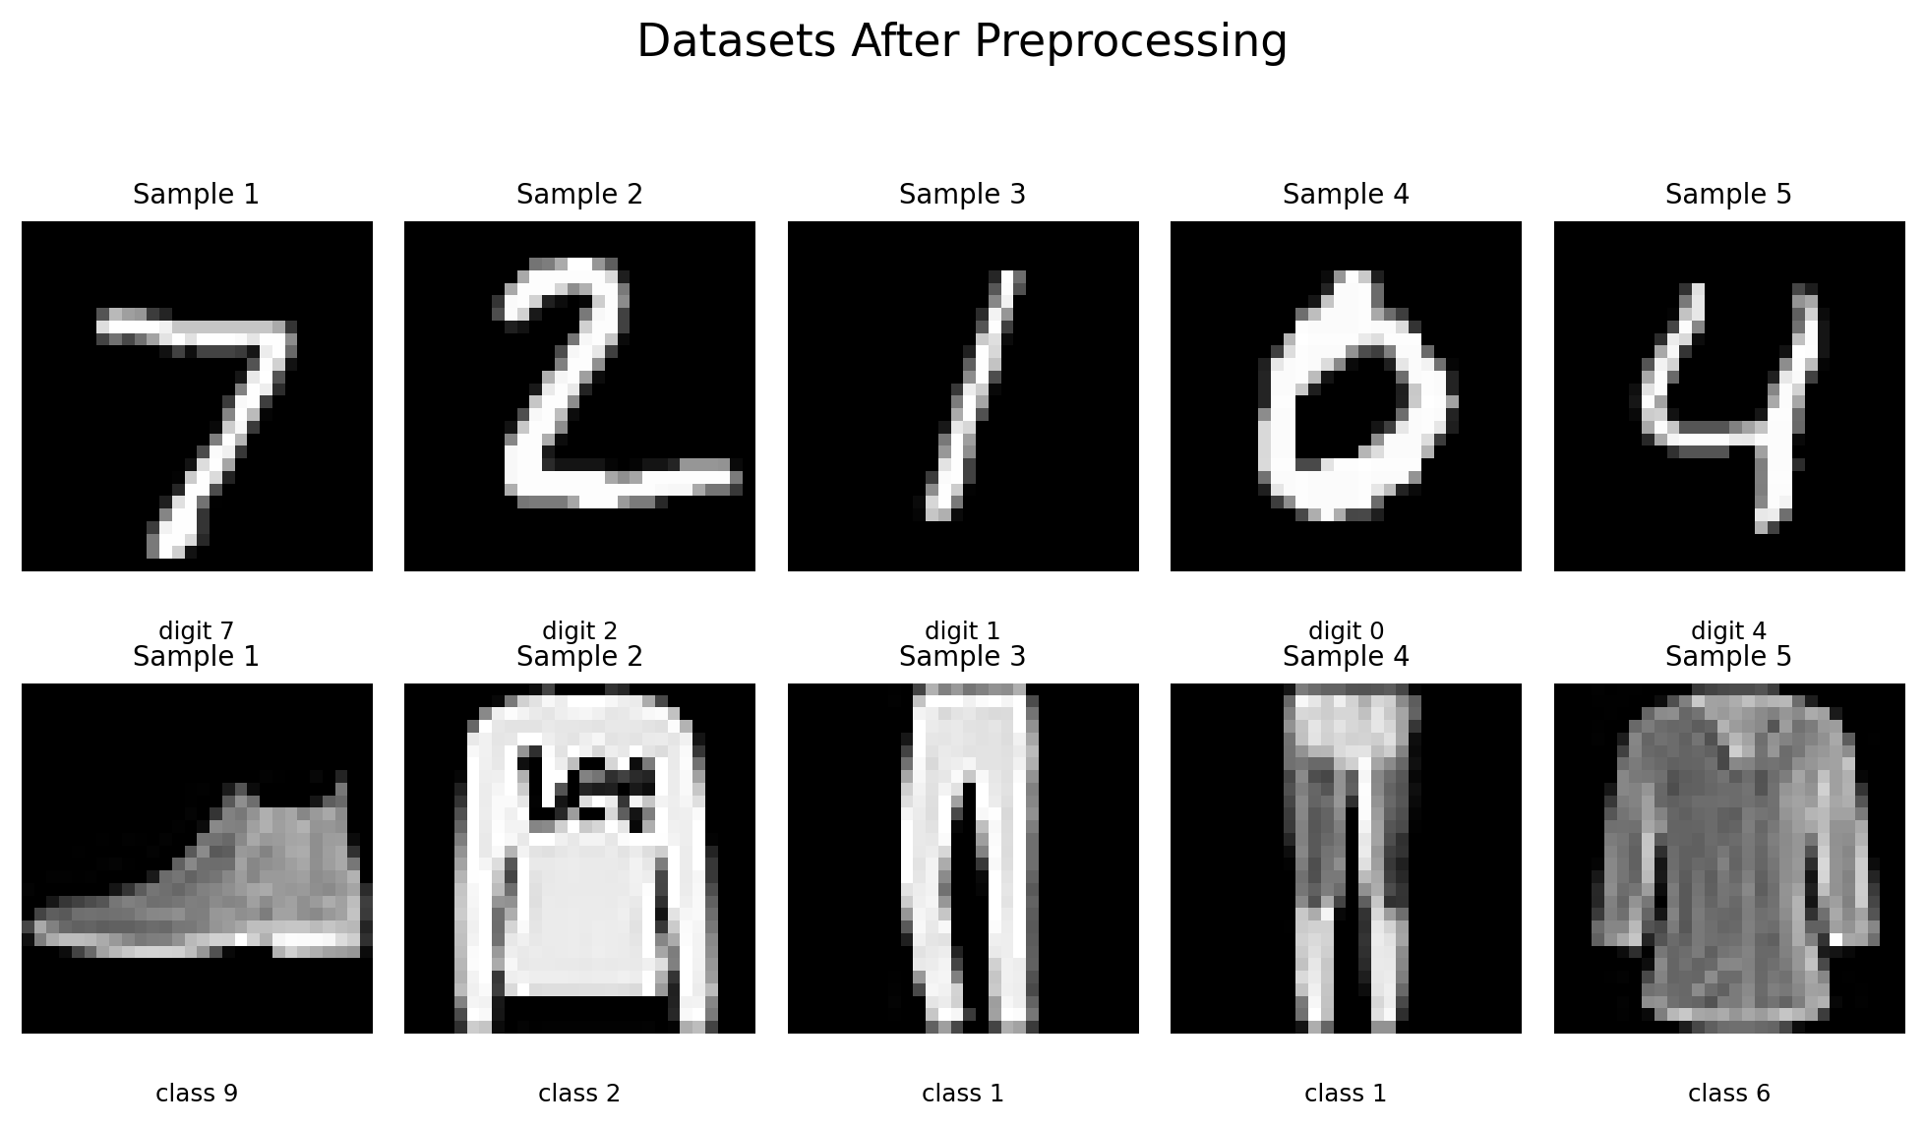
Data and Preprocessing
Grayscale 28x28
Tensor Conversion
Normalized to 0-1
Training and Testing Split for PCA vs. AE
Shape: Nx1x28x28
Notes:
Kaleb - Images were converted to tensors and normalized to 0..1, which allowed MSE, PSNR, and SSIM to be computed on the same scale.

Slide 6
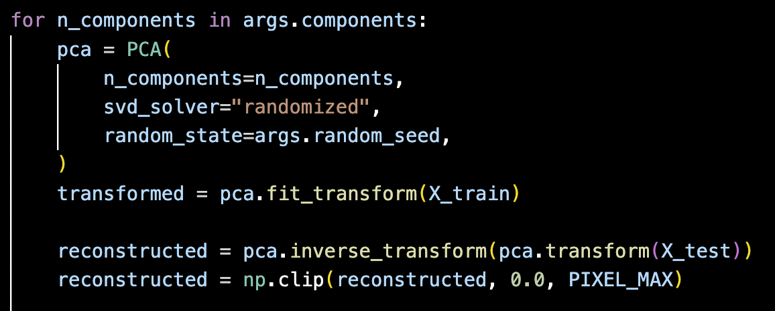
PCA Implementation
Core Feature | Meaning
pca.fit(X_train) | Make PCA model with a set number of latent dimensions, then fit to training set
latent = pca.transform(X_test) | Project test image into lower dimension
reconstructed = pca.inverse_transform(latent) | Recreate the image
Notes:
TJ

Slide 7
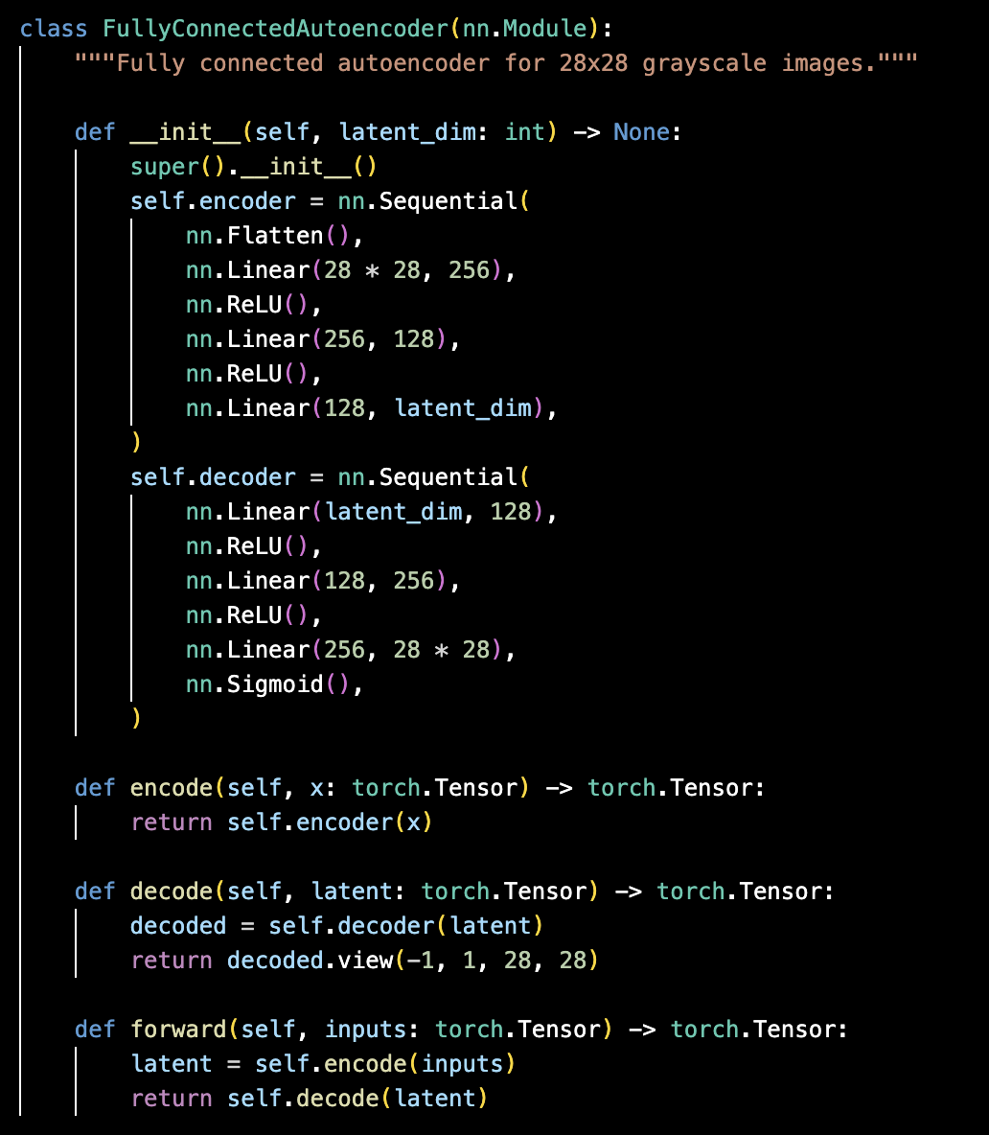
AE Implementation
Core Feature | Meaning
self.encoder = nn.Sequential… | Compresses each 28x28 image into a smaller latent representation that keeps the most useful features
self.decoder = nn.Sequential… | Reconstructs the image from the latent code, expanding it back into pixel space
forward() | Defines the full reconstruction path
Notes:
Kaleb

Slide 8
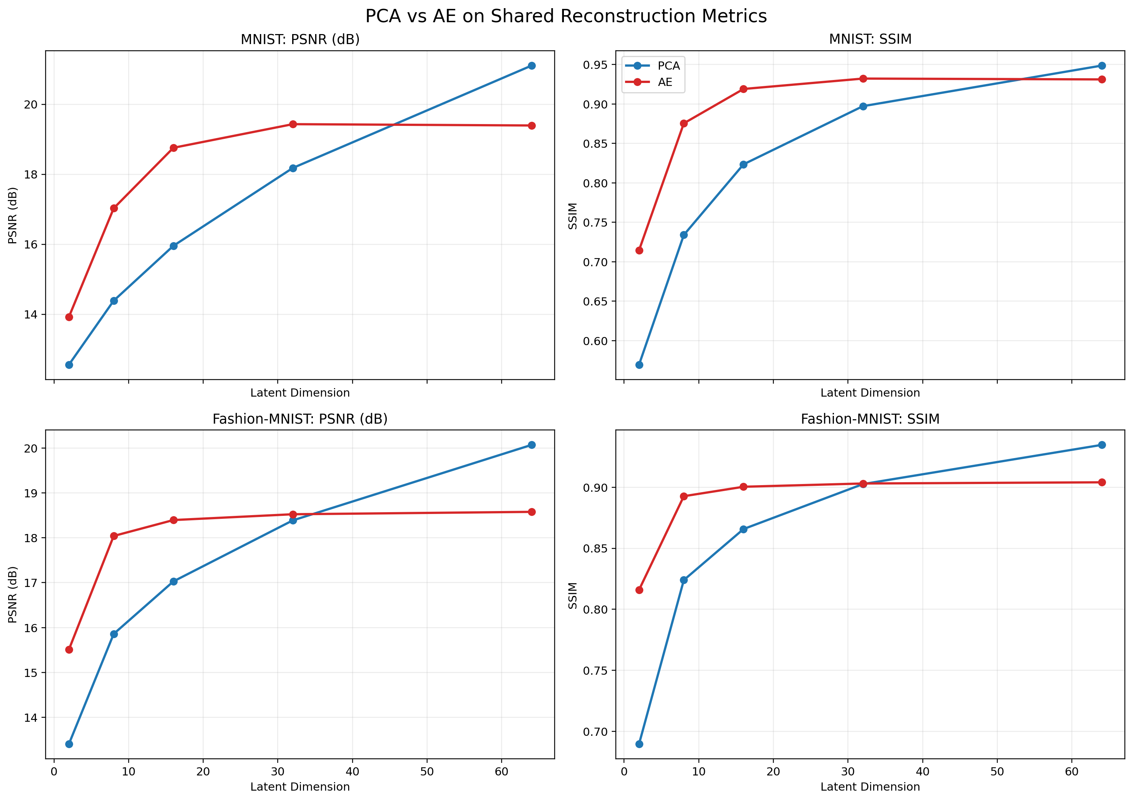
Initial Experimental Results: Quantitative
Notes:
TJ
PSNR: Peak Signal-to-Noise Ratio - measures how close the reconstructed image is to the original based on pixel error. Higher is better.
SSIM: Structural Similarity Index Measure - measures how similar the reconstructed image is to the original in perceived structure and visual organization. Higher is better.
dB: decibels

Slide 9
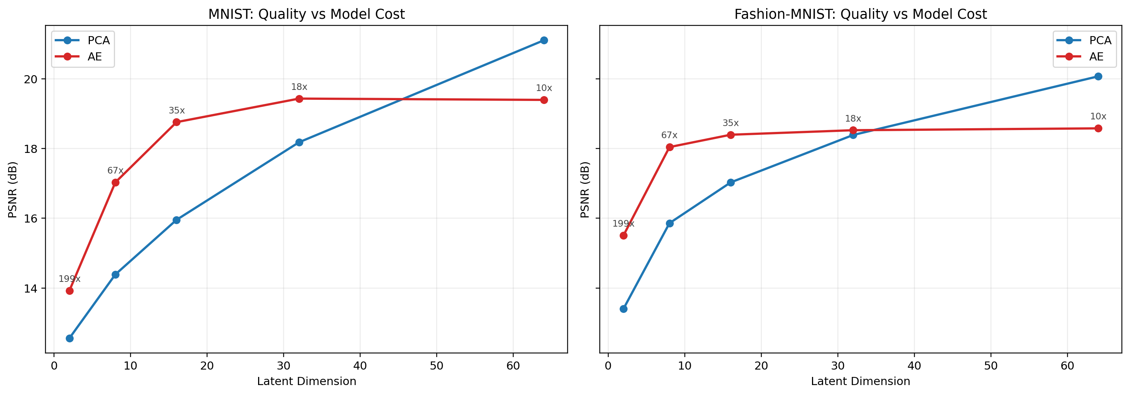
Tradeoffs
Notes:
Kaleb

Slide 10
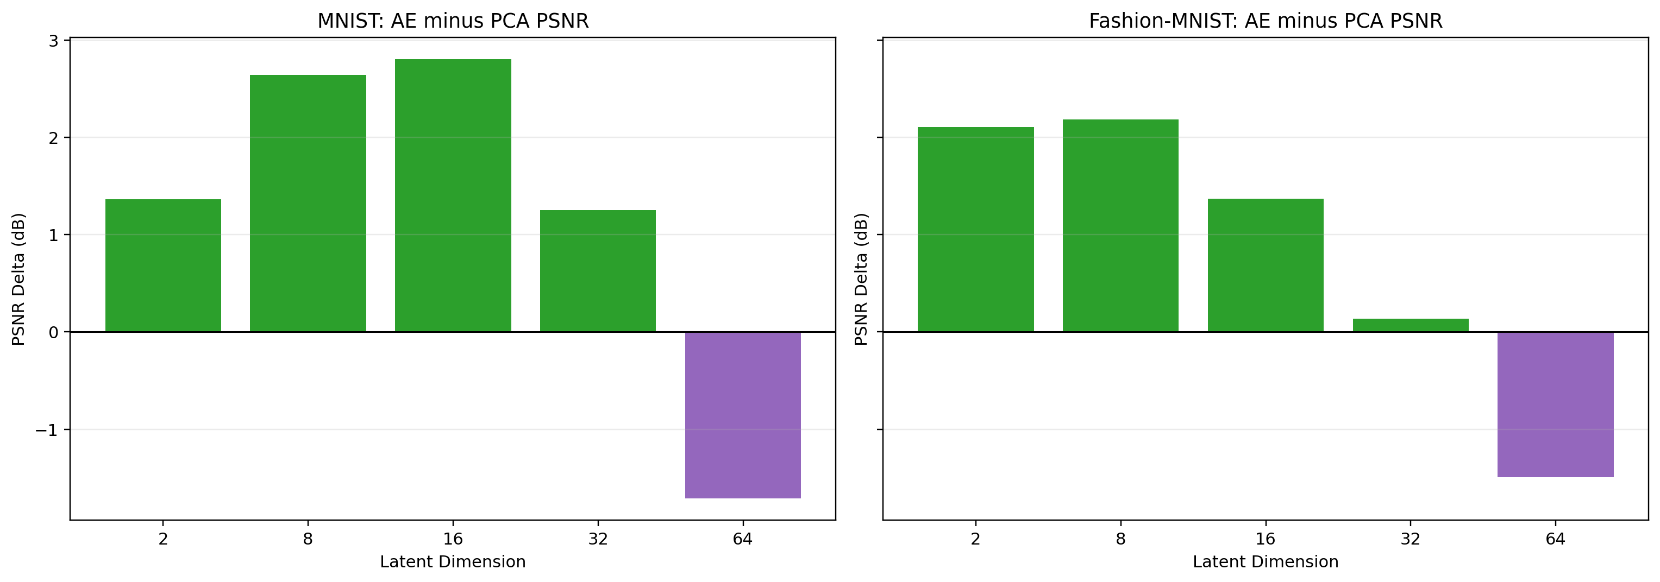
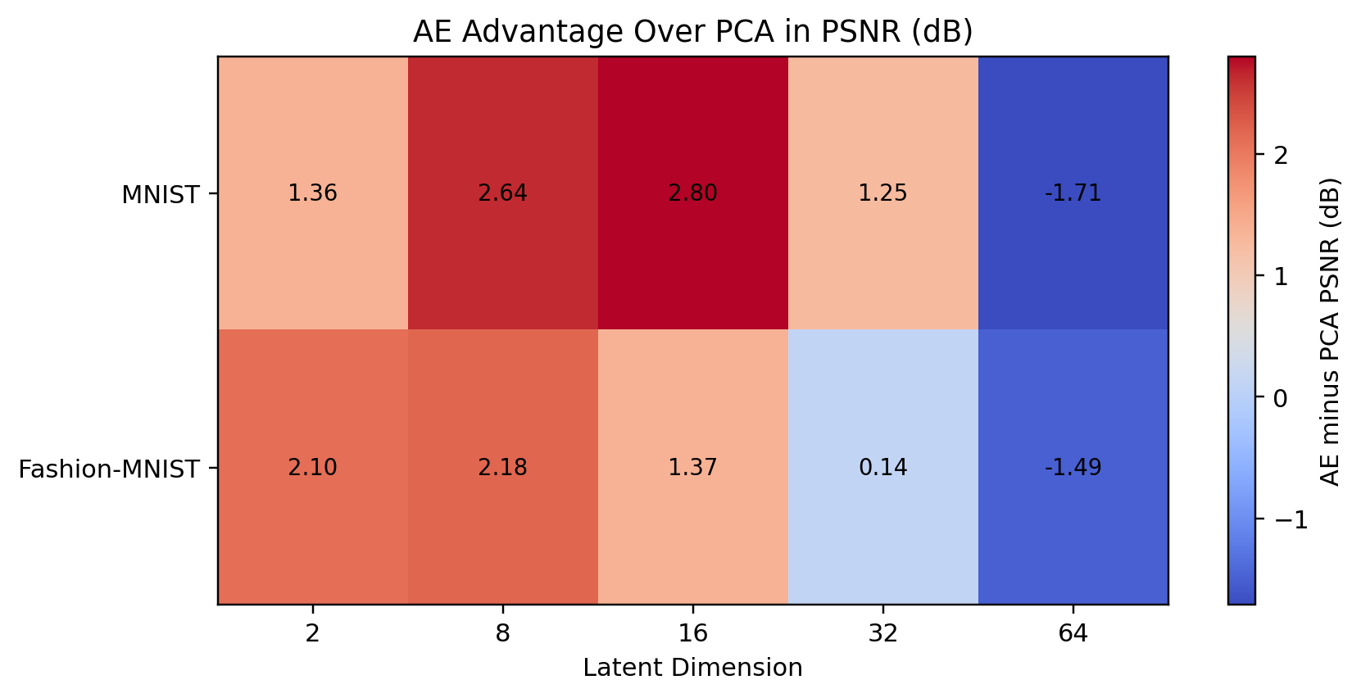
Details
Notes:
TJ
- Green bars above zero mean AE is better.
Purple bars below zero mean PCA is better.
- Warm colors mean AE has the advantage.
- Cool colors mean PCA has the advantage.

Slide 11
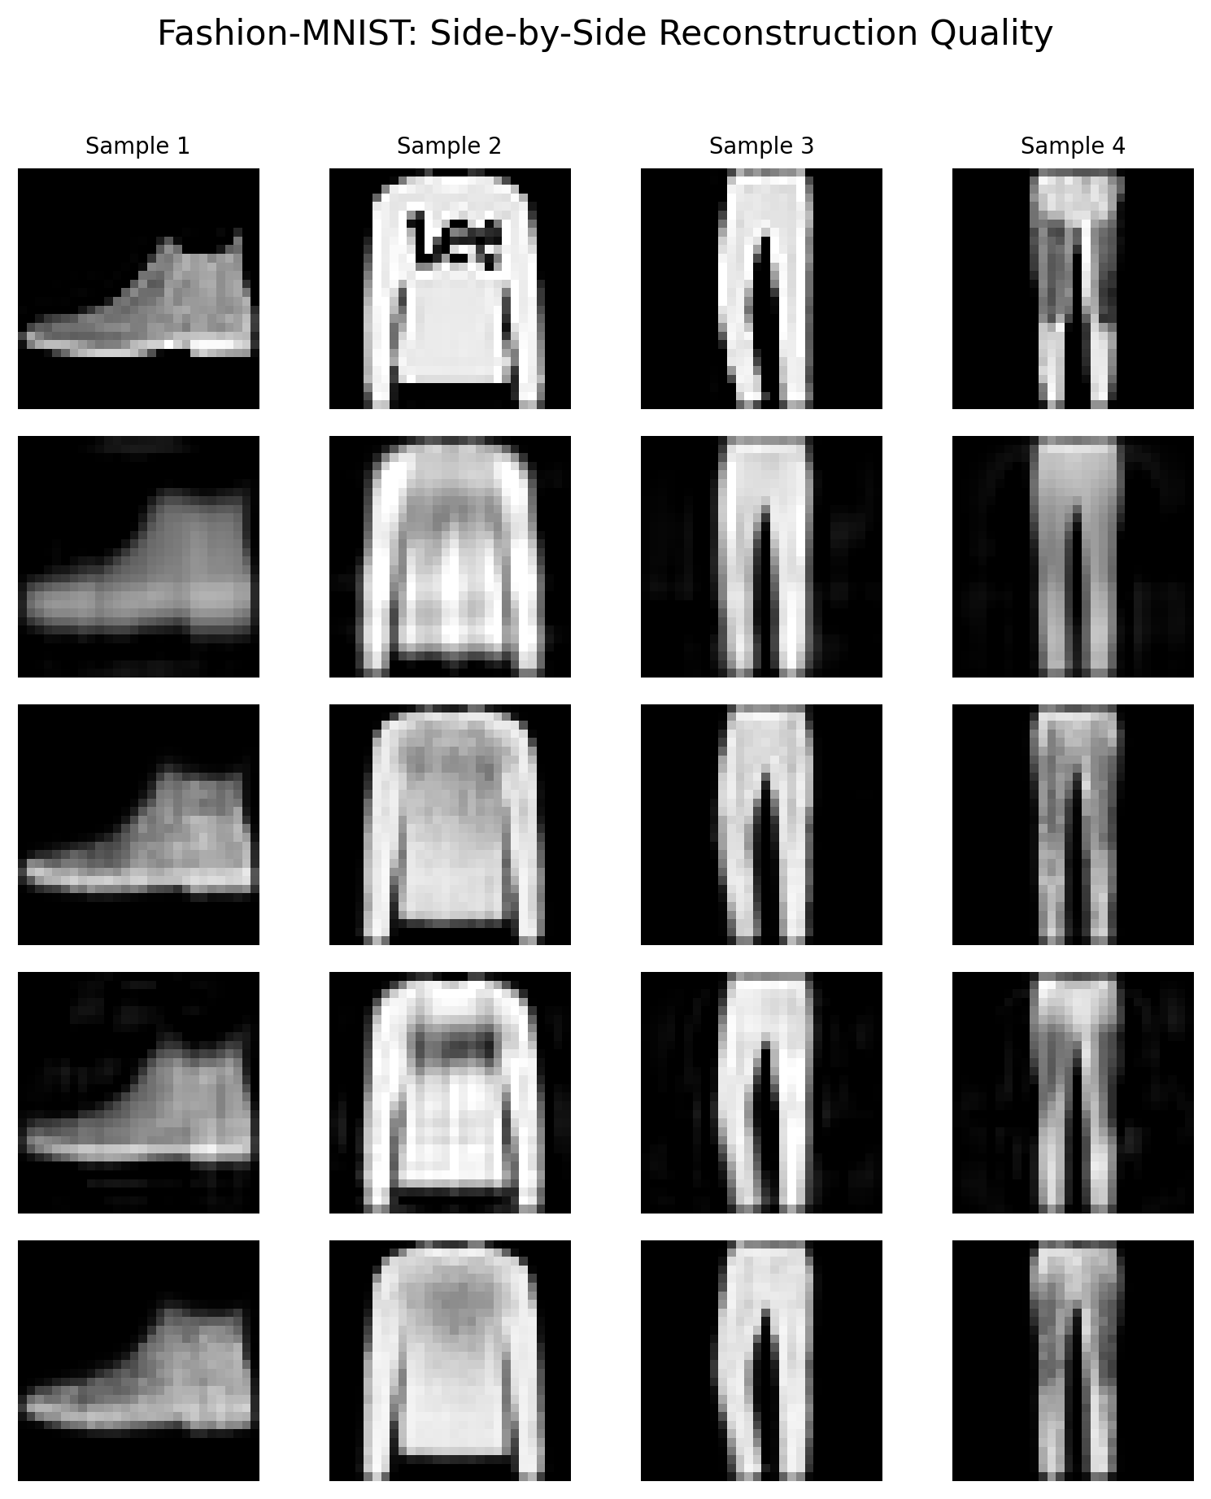
Initial Experimental Results: Visuals
Notes:
Kaleb

Slide 12
Interpretations and Tradeoffs
AE beats PCA at small and medium latent sizes on both MNIST and Fashion-MNIST
PCA wins again at latent size 64
PCA is much more parameter-efficient and easier to train
Best choice depends on the goal:
  Use AE when the bottleneck is tight and reconstruction quality matters most
  Use PCA when simplicity, speed, and efficiency matter
Notes:
TJ

Slide 13
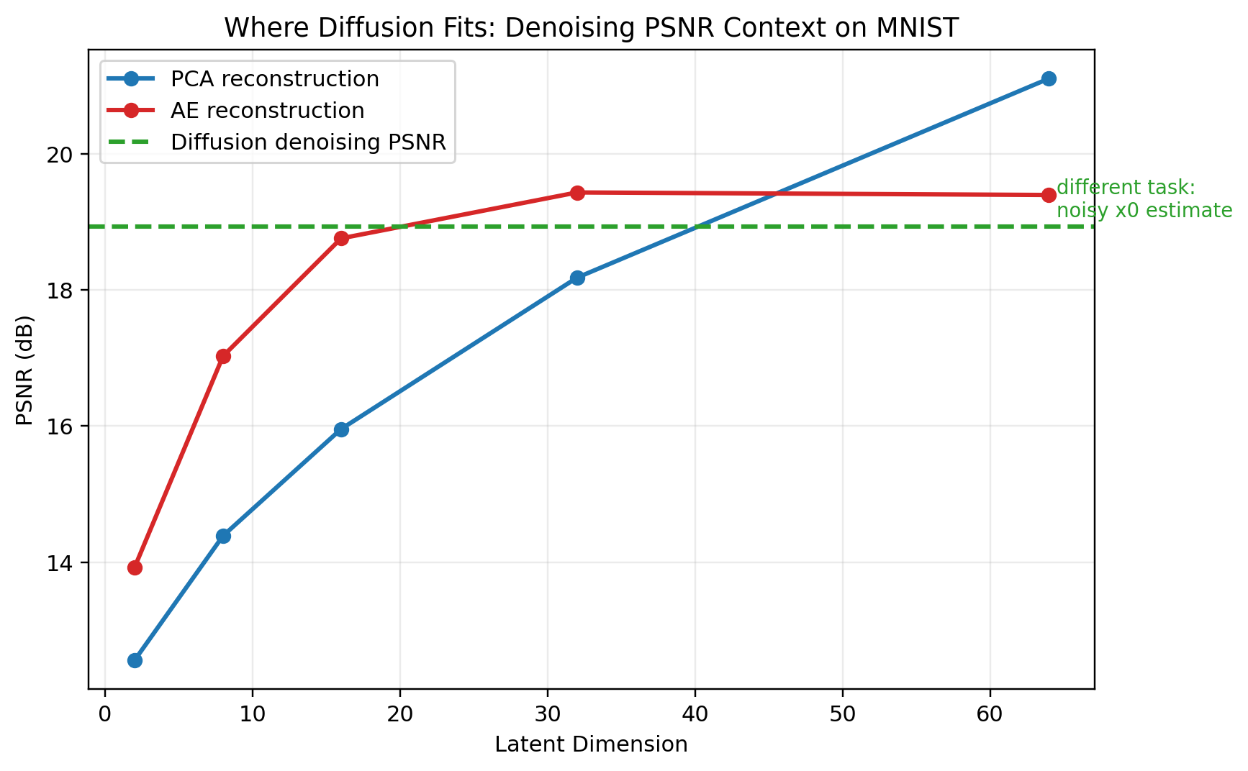
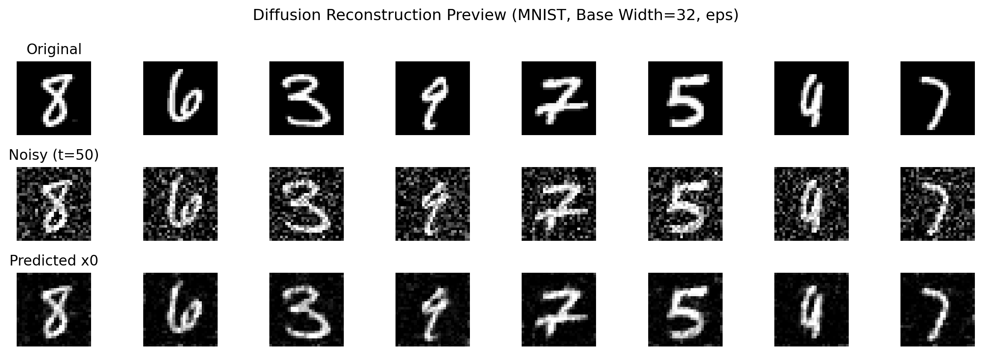
Bonus: Diffusion
Notes:
Kaleb

Slide 14
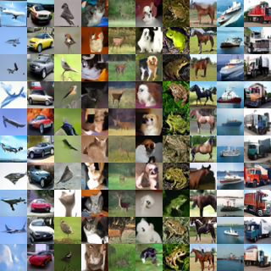
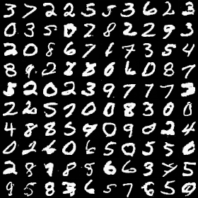
Bonus: Diffusion
Notes:
TJ

Slide 15
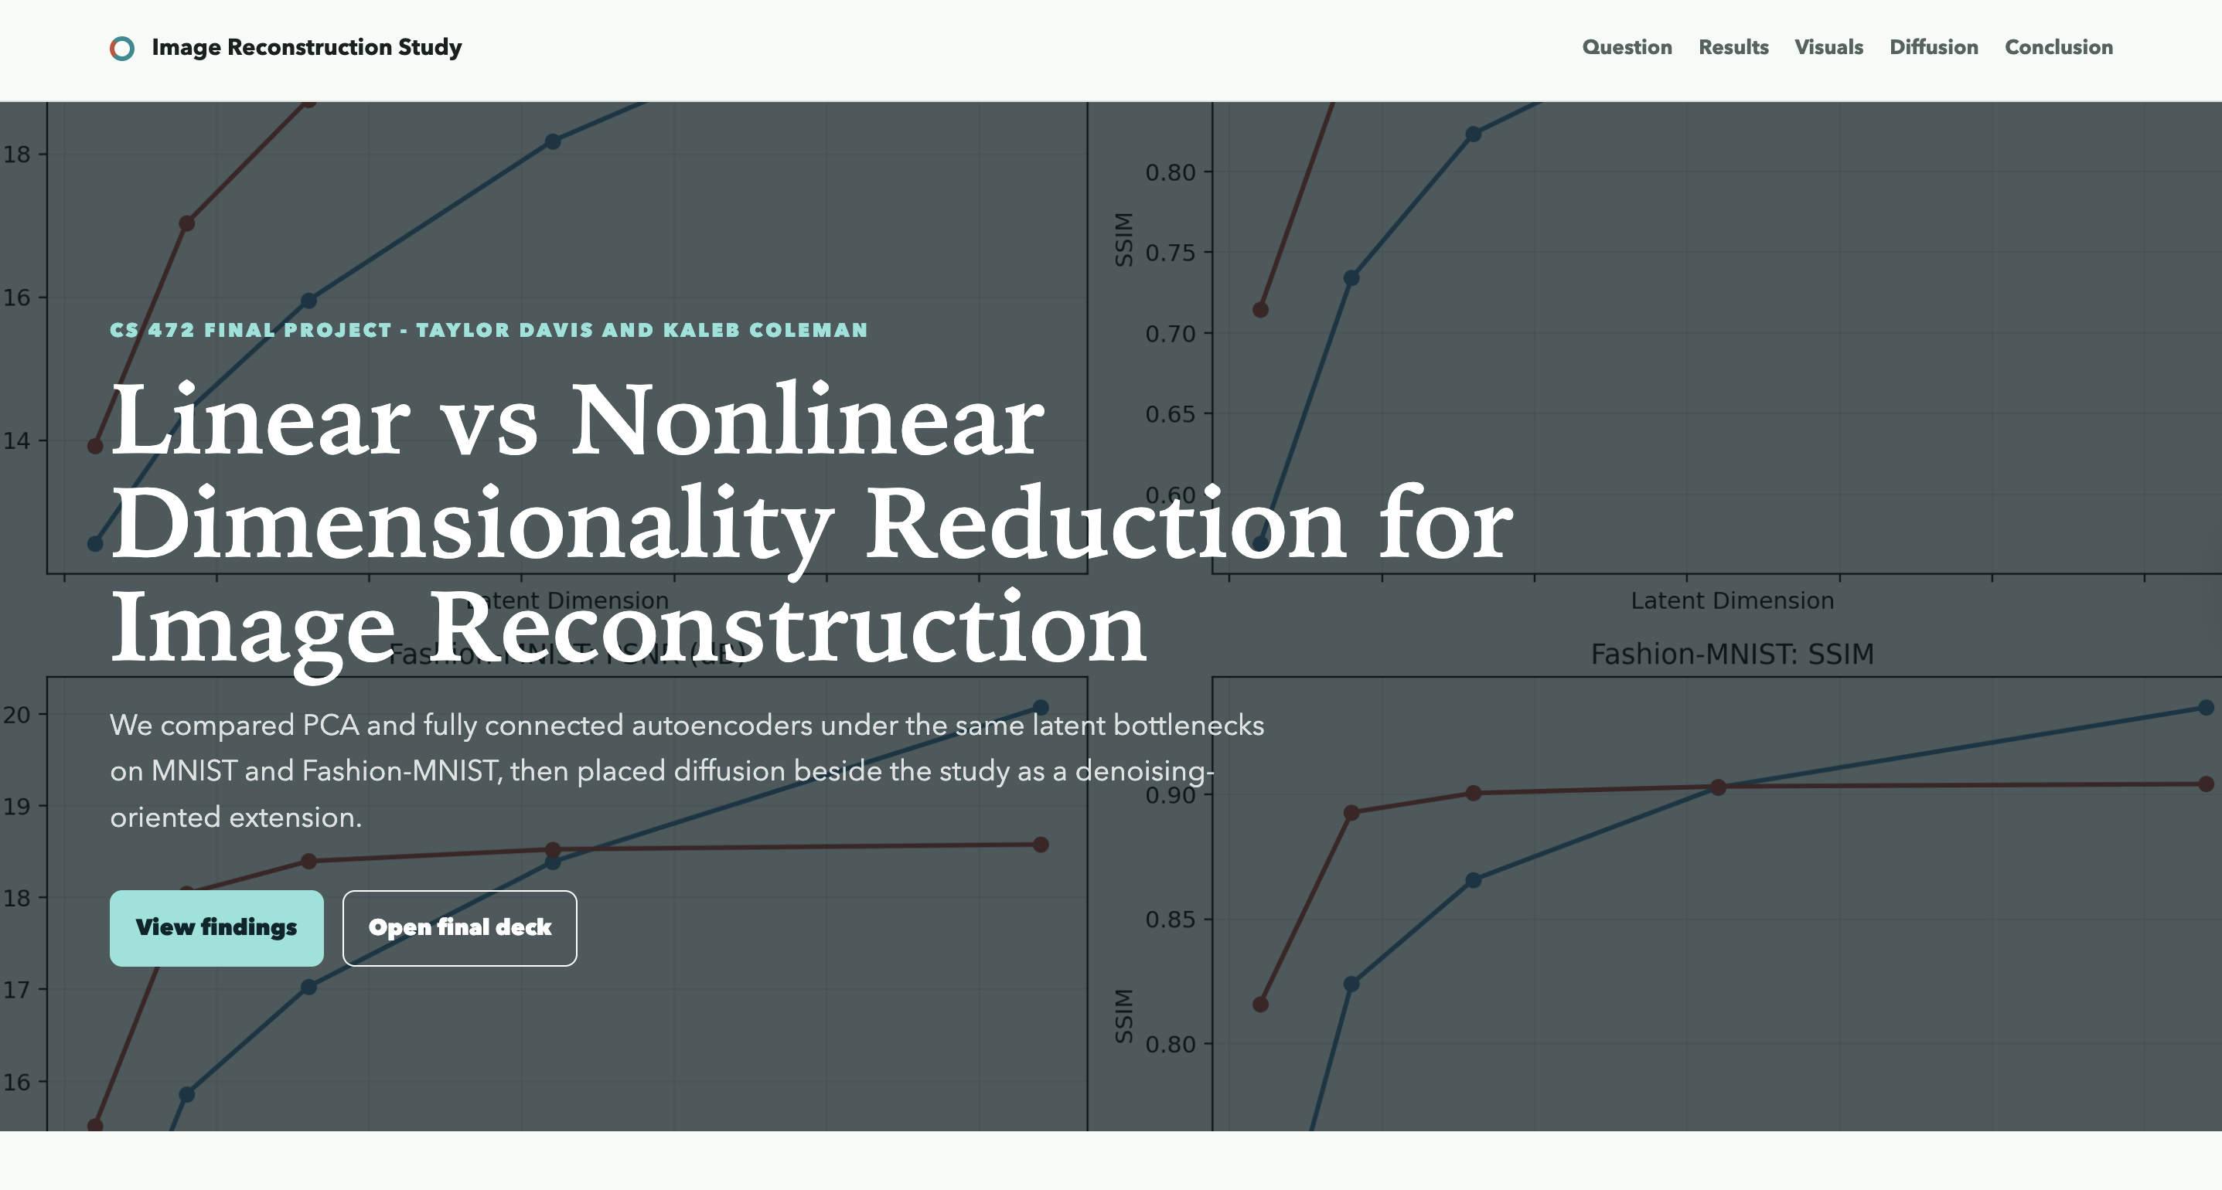
GitHub and Website
https://github.com/tjdavis51/Linear-vs-Nonlinear-Dimensionality-Reduction-in-Image-Reconstruction
https://tjdavis51.github.io/Linear-vs-Nonlinear-Dimensionality-Reduction-in-Image-Reconstruction/
Notes:
Kaleb

Slide 16
Thank You
Are there any questions?

